Slide 1
ESc201 : Introduction to Electronics
Boolean Algebra
Vipul Arora
Dept. of Electrical Engineering
IIT Kanpur
Mar 23, 2023

Slide 2
Example (recap)
Adding or subtracting numbers with addition operation alone
To get a negative number, 2’s complement of positive number is taken
2’s comp.
of +2
2’s comp.
of +5
2’s comp.
of +5
2’s comp.
of +2
2’s complement is 0011 = 3
2’s complement is 0111 = 7

Slide 3
Boolean Algebra
Algebra on Binary numbers
False
A variable x can take two values {0,1}
No
0
Low voltage
Basic operations:
True
Yes
1
High voltage
y is 1 if and only if both x₁ and x₂ are 1, otherwise zero
Truth Table

Slide 4
Basic operations:
y is 1 if either x₁ or x₂ is 1. y= 0 if and only if both variables are zero

Slide 5
Boolean Algebra
Basic Postulates
Identity element
Commutative
Distributive
Complement
Basic Theorems

Slide 6
Proving Theorems

Slide 7
Proving Theorems
DeMorgan’s Theorem

Slide 8
Simplification of Boolean expressions

Slide 9
Deriving Expressions from Truth Tables

Slide 10
Function of Boolean variables
y = 1 when x₁ is 0 and x₂ is 1
Boolean expression

Slide 11
Obtaining Boolean expressions from truth Table

Slide 12
Obtaining Boolean expressions from truth Table
Instead of writing expressions as sum of terms that make y equal to 1, we can also write expressions using terms that make y equal to 0

Slide 13
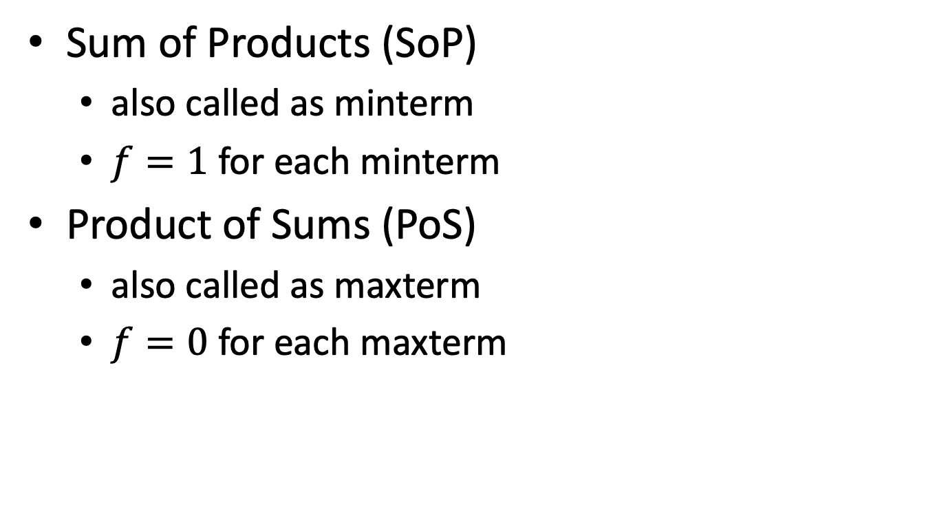
Two ways to represent functions
Sum of Products (SoP)
also called as minterm
$f=1$ for each minterm
Product of Sums (PoS)
also called as maxterm
$f=0$ for each maxterm

Slide 15
Obtaining Boolean expressions from truth Table
Sum of Products (SOP) form
Product of Sum (POS) form

Slide 16
Implementing the circuits

Slide 17
Implementing Boolean expressions
Elementary Gates
Why call it a gate?

Slide 19
y is 1 if only one variable is 1 and the other is zero

Slide 20
Gates with more than 2 inputs
y = 1 only if odd number of inputs is 1

Slide 21
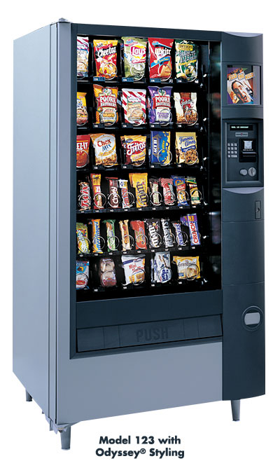
How do we get the chocolate?

Slide 22
Design Flow
System Description
Truth Table
Boolean Expression
Minimized
Boolean Expression
Gate Netlist

Slide 23
Implementing Boolean expressions using gates

